Slide 1

NORMAN PUTSURE COLLEGE, CHUMUKEDIMA
ART CLUB –ANNUAL REPORT 1ST SEMESTER
2022-2023[JULY-MARCH]
An art is anything that brings the divine experience of aestheticism. It sets the tune to life and also an inevitable factor of the students life. The motto of art club aims at honouring the artistic talent of the students of [ NORMAN PUTSURE COLLEGE].
The art club has also conducted many events and activities, with the serious task of continuing the tradition of perpetuating the artistic vibe and spirit throughout the campus.
Ensuing forth is the annual report of the art club which draws a vivid picture of the last years activities and events.
Under the guidance of teachers in charge[ Asst. Professor Miss NUNGSANGMONGLA OZUKUM, Asst. Professor Miss AVANI and Librarian Sir KELHOUVITO KENSE] and the students of the club, has conducted handful of events and activities till now.
The following are the activities and events organised by the art club:

Slide 2
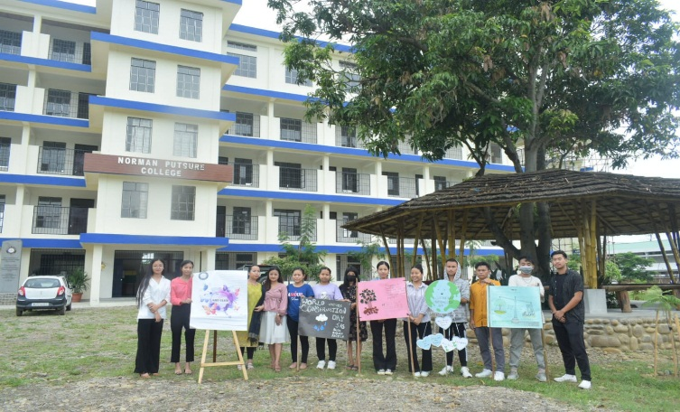
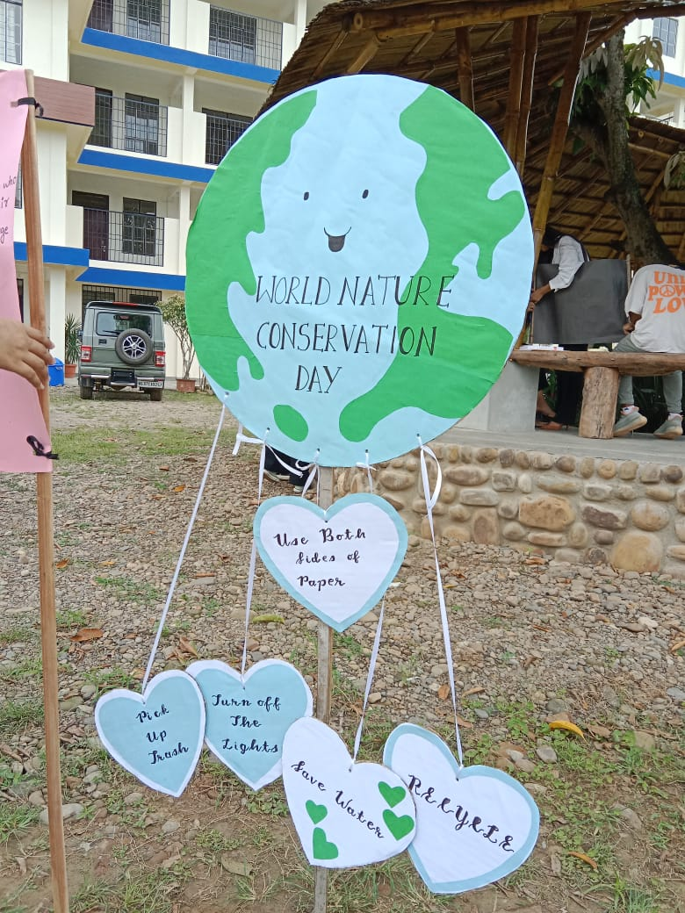
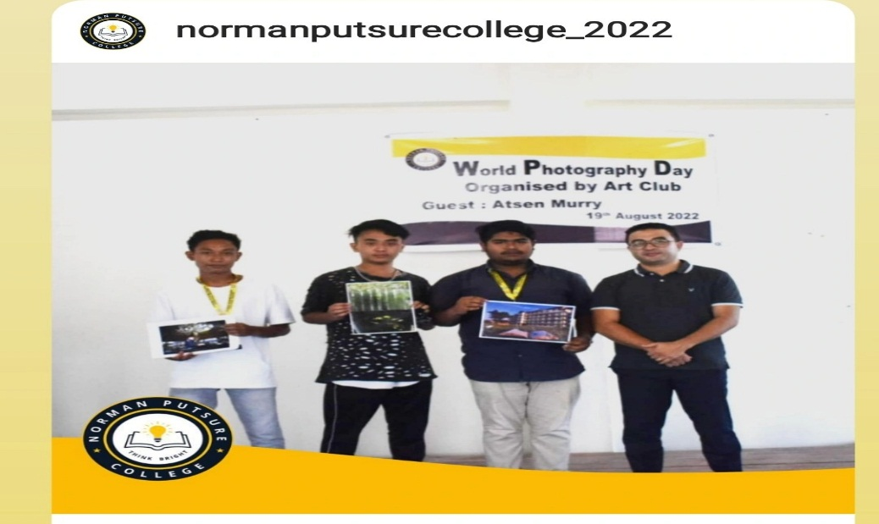
1. World nature conservation day was conducted by Art Club on 28th July2022 by making banners.
2. On the 19th of august2022, World Photography Day was organised by the Art Club with chief guest ATSEN MURRY [photographer].The club hosted a photography competition in which the winner was SHIBU MAJUMDAR, first runner up BWENLO MESUNG and second runner up YANCHANG were awarded with cash prize.

Slide 3
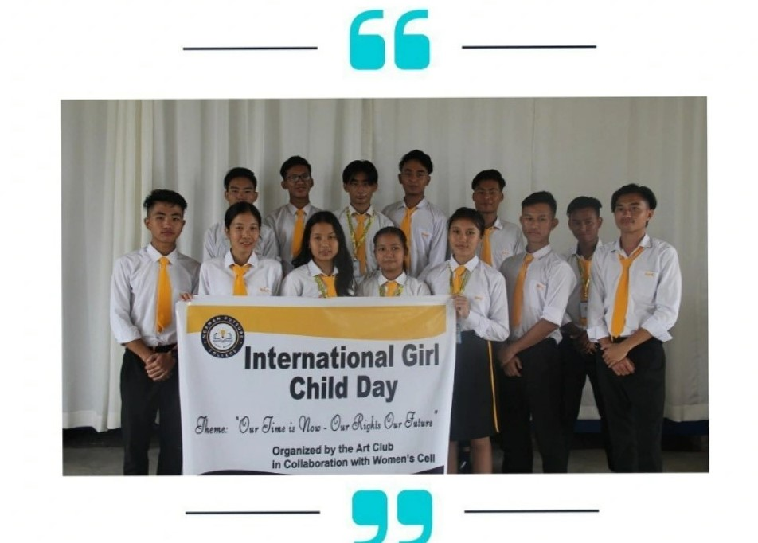
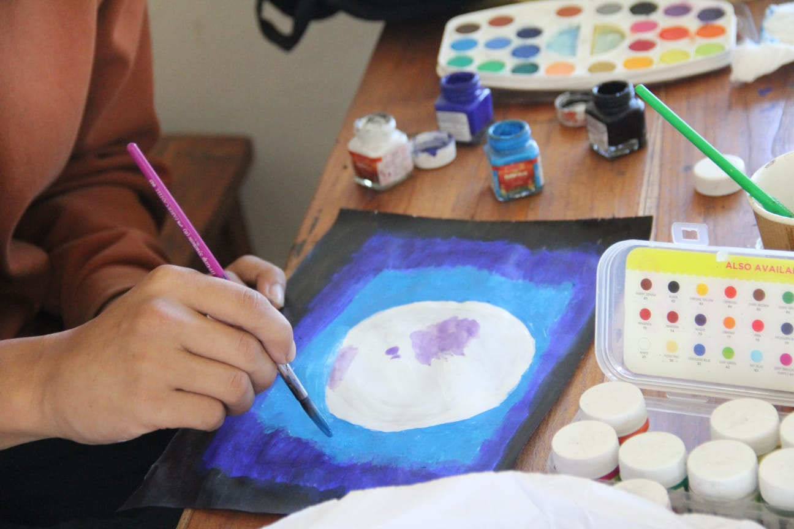
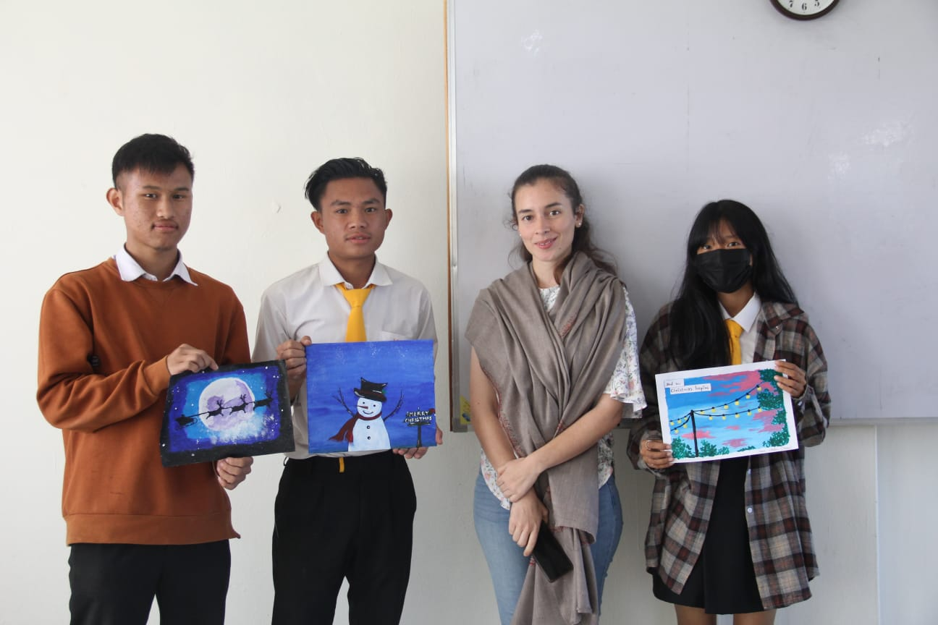
3. On 11th October 2022, “International Girl Child Day” Was Organised by Art Club in collaboration with the women’s cell on the theme ‘Our Time Is Now-our Rights Our Future’.
4. Art competition event for students was conducted on 9th December 2022. The winners were 1st THEJAKHWELIE, 2nd MHABENI YANTHAN and 3rd BONGZILI SANGTAM were awarded with cash prize.

Slide 4
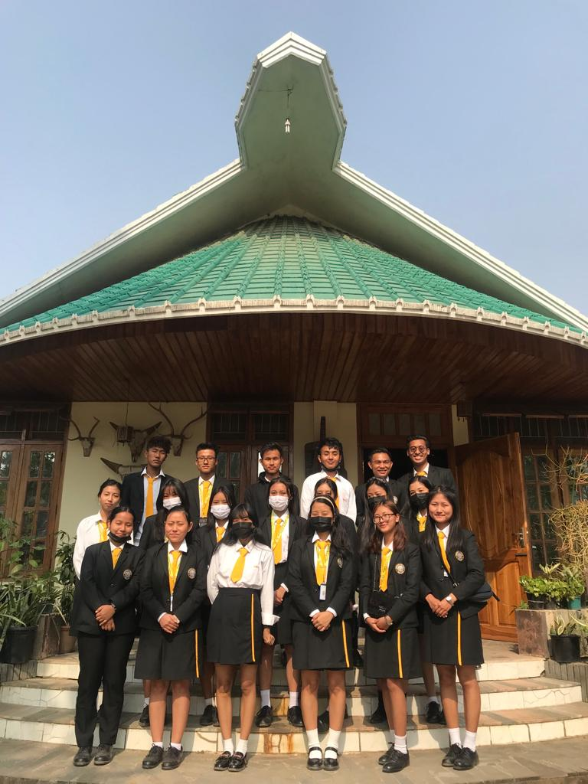
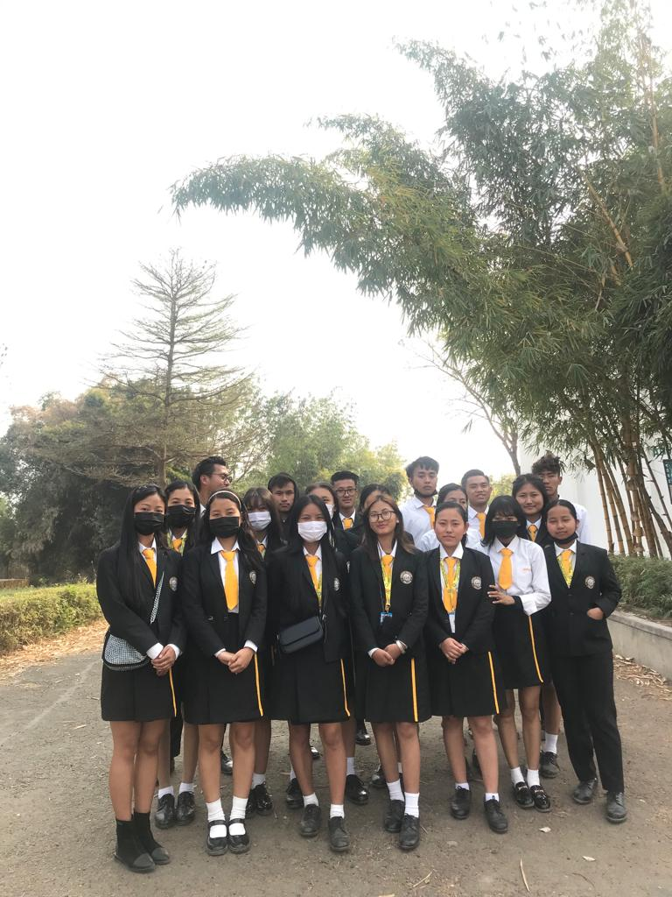
5. Making of handmade duster(DIY) during the club activity on 23th January 2023.
6. Art club in collaboration with Literature club went on a mini trip to CHUMPO MUSEUM followed by lunch at BAMBOO RESOURCE CENTRE on the day of 13th February 2023 from 12:10 – 2:00pm.

Slide 5
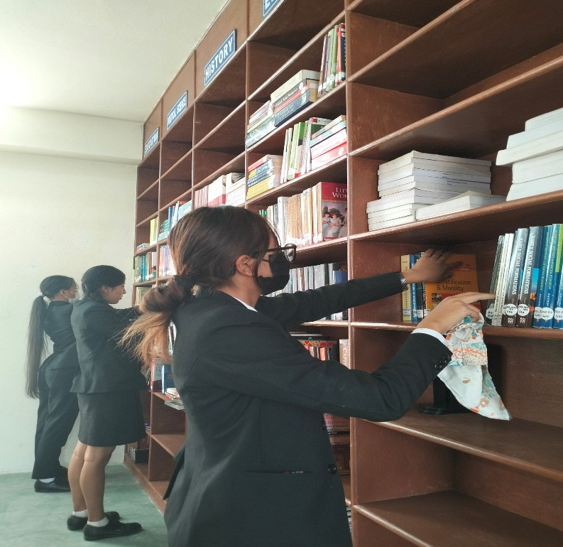
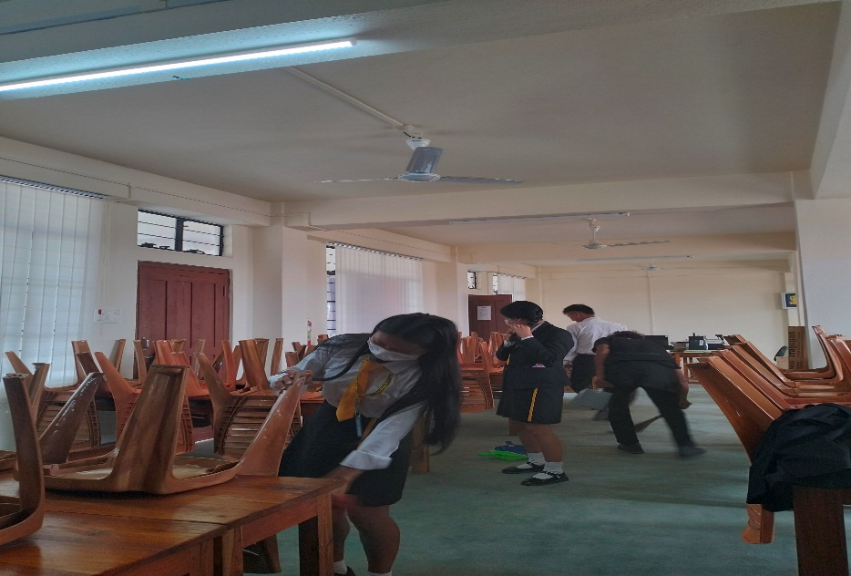
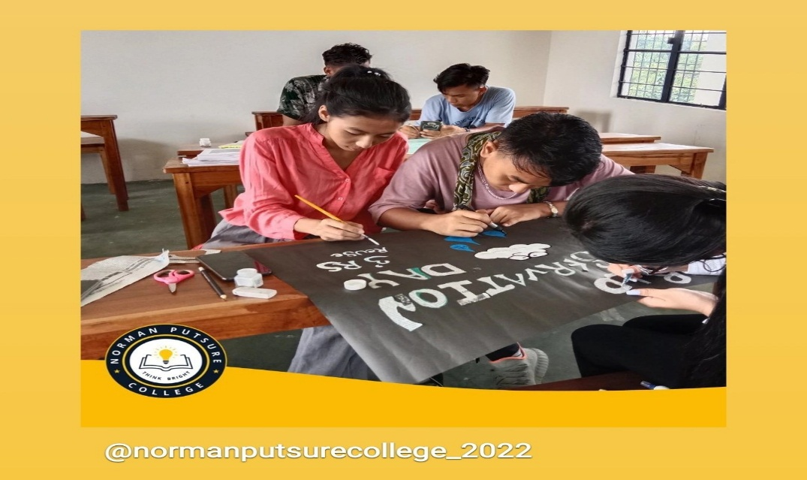
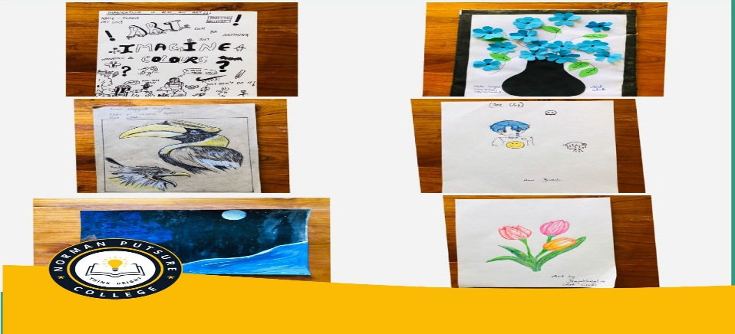
7. The Art Club members helped the literature club with cleaning of the library during library week week on 20th February 2023.
8.Art club during club activities-

Slide 6
To conclude, the Art Club has always encouraged the students to express their thoughts , feelings and creativity through the various events and activities. The club provides an opportunity to the students to let their imagination run wild by providing them with the sight to see things in a different way.
The vision of the club is one of inclusion and creativity and personal experience through art.
ALILA SANGTAM
Department of sociology

